Slide 1
Cluster Analysis Using kMeans

Slide 2
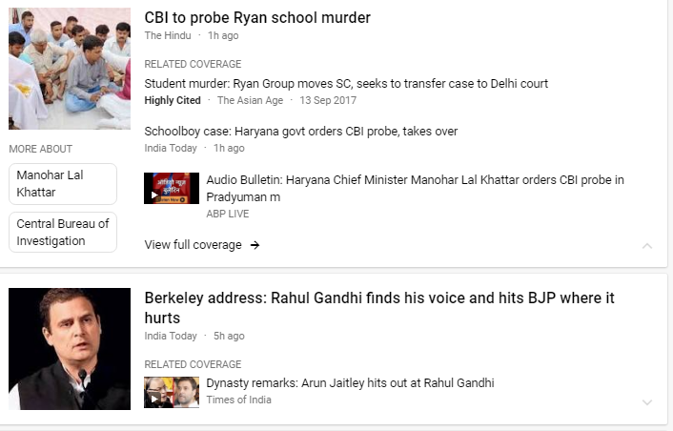
Cluster Analysis
Divide data into similar groups
Goals of cluster analysis:
Clustering for understanding data (Info. retrieval, climate, business)
Clustering as a utility (summarization, compression, nearest neighbour search)

Slide 3
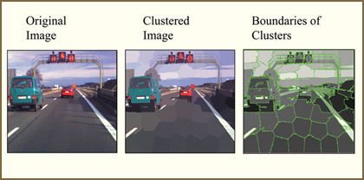
Cluster Analysis
Divide data into similar groups
Goals of cluster analysis:
Clustering for understanding data (Info. retrieval, climate, business)
Clustering as a utility (summarization, compression, nearest neighbour search)

Slide 4
K-means Clustering
Given k, the k-means algorithm consists of four steps:
Select initial centroids at random.
Assign each object to the cluster with the nearest centroid.
Compute each centroid as the mean of the objects assigned to it.
Repeat previous 2 steps until there is no change.

Slide 5
K-means Clustering
Example

Slide 6
K-means example (K=2)

Slide 7
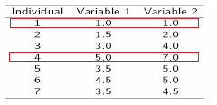
K-means example (K=2)
Initialization: Randomly we choose following two centroids (k=2) for two clusters.
In this case the 2 centroid are: m1=(1.0,1.0) and m2=(5.0,7.0).

Slide 8
Centroid Calculation
Let us say we have following points:
(x1, y1)
(x2, y2)
(x3, y3)
...
(xn, yn)
What is the centroid?
Centroid:
(x1 + x2 + x3 + ... + xn) / n
(y1 + y2 + y3 + ... + yn) / n

Slide 9



K-means example (K=2)
Thus, we obtain two clusters containing:
{1,2,3} and {4,5,6,7}.
Their new centroids are:

Slide 10
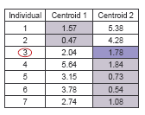
K-means example (K=2)
Now using these centroids we compute the Euclidean distance of each object, as shown in table.
Therefore, the new clusters are:
{1,2} and {3,4,5,6,7}
Next centroids are: m1=(1.25,1.5) and m2 = (3.9,5.1)

Slide 11
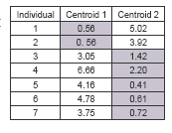
K-means example (K=2)
The clusters obtained are:
{1,2} and {3,4,5,6,7}
Therefore, there is no change in the cluster.
Thus, the algorithm comes to a halt
Final result consist of 2 clusters {1,2} and {3,4,5,6,7}

Slide 12
K-means example (K=2)

Slide 13
Thank You!

